Slide 1
City of Scottsdale Senior Center at Granite Reef

Slide 2
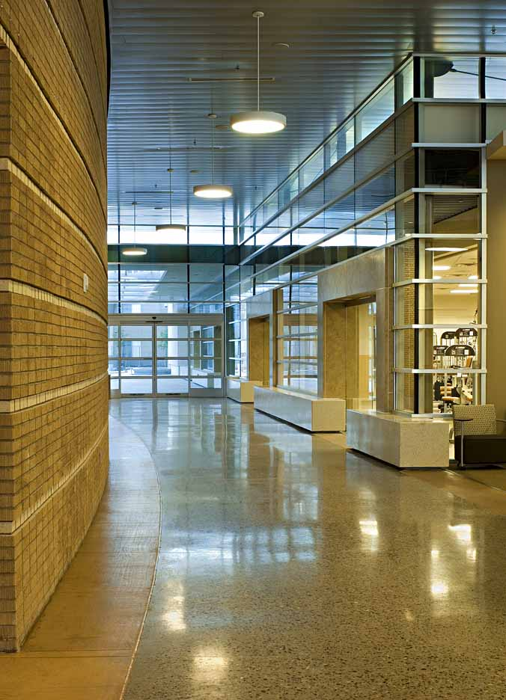
Project Data
CITY OF SCOTTSDALE SENIOR CENTER AT GRANITE REEF
Scottsdale, Arizona
July, 2006
41,898 GSF
$8,970,503
Cal Wadsworth Const.
Cal Wadsworth
Ray Rankin
Ray Rankin
Location:
Completed:
Building Area:
Construction Cost:
Contractor:
Project Manager:
Assistant PM:
Superintendant:
City of Scottsdale Senior Center at Granite Reef

Slide 3
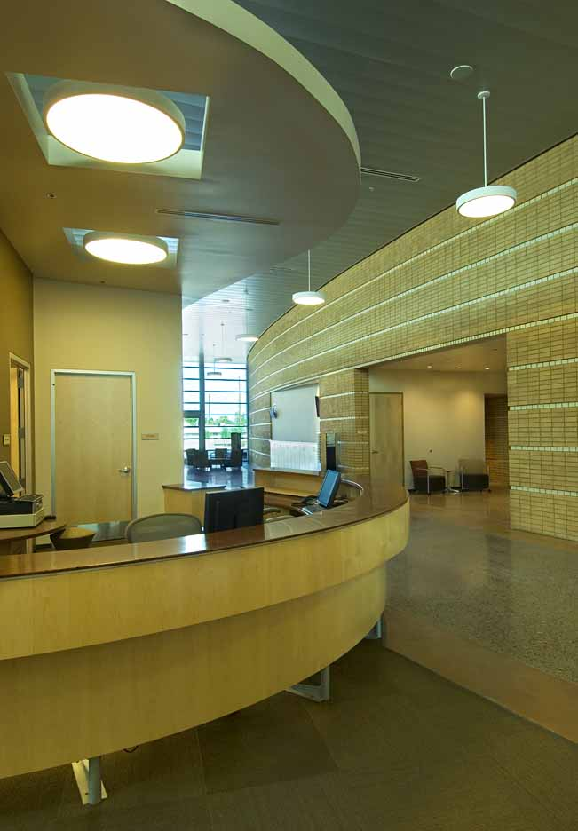
City of Scottsdale Senior Center at Granite Reef
Concept Statement
The Scottsdale Senior Center at Granite Reef was designed and built to artfully meld a comfortable and inviting setting with modern technology and design so as to create an environmentally-conscious solution of enduring value.

Slide 4
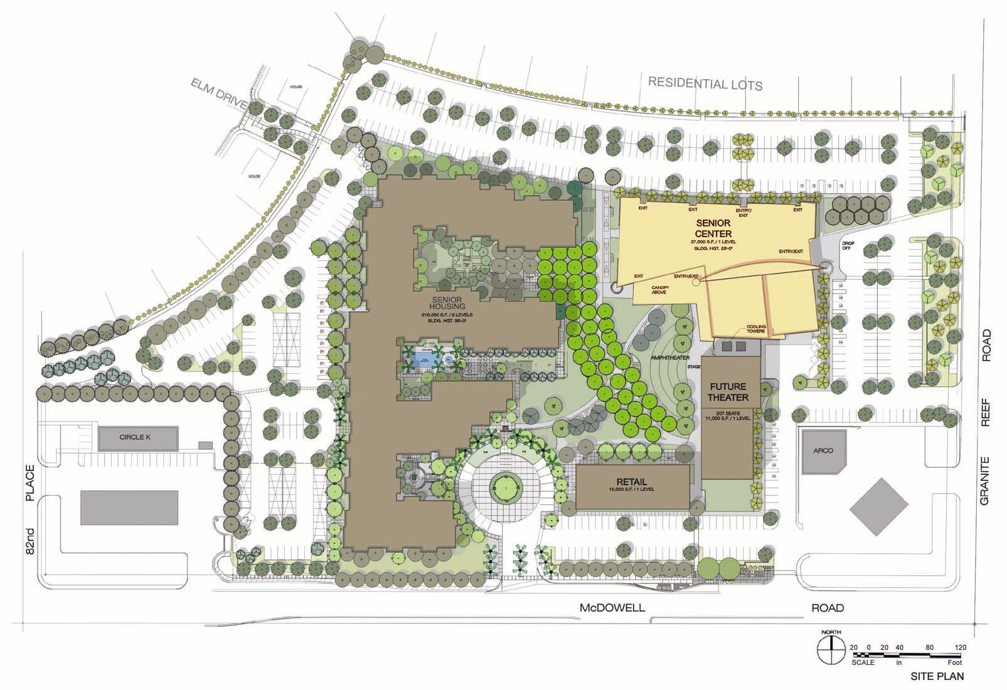
Site Plan/ Context
The Senior Center is part of a 13-acre development that also includes 220 units of privately developed senior housing, a retail center and a community theater. The Senior Center’s site improvements included the development’s one-acre courtyard with its play courts, fountains and landscaped walks.
City of Scottsdale Senior Center at Granite Reef

Slide 5
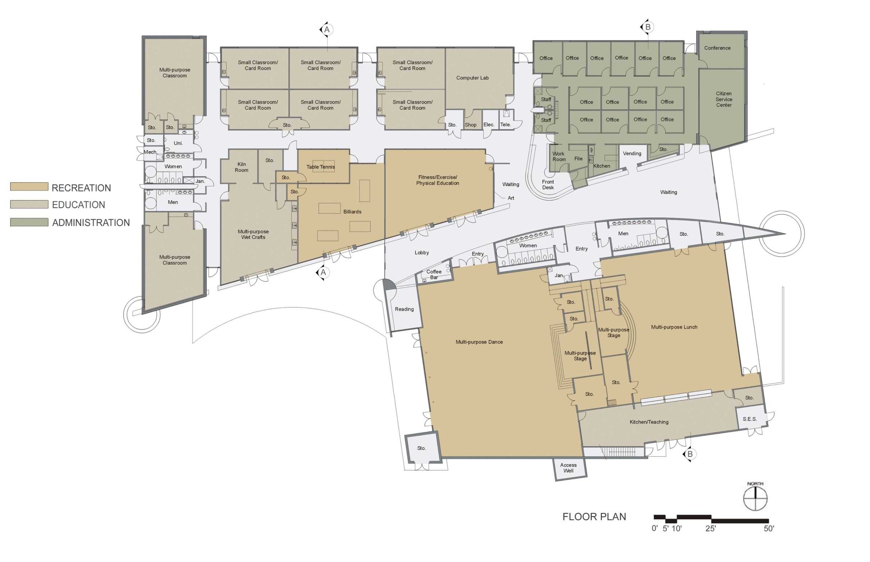
Floor Plan
A host of functional and energy–friendly features are on display in the building’s floor plan. These include heavily insulated, mediated spaces (with few windows) at the west and east side of the building; a central utility core with its significant thermal mass; and clearstory-lined corridors oriented to optimize daylight while minimizing heat gain.
City of Scottsdale Senior Center at Granite Reef

Slide 6
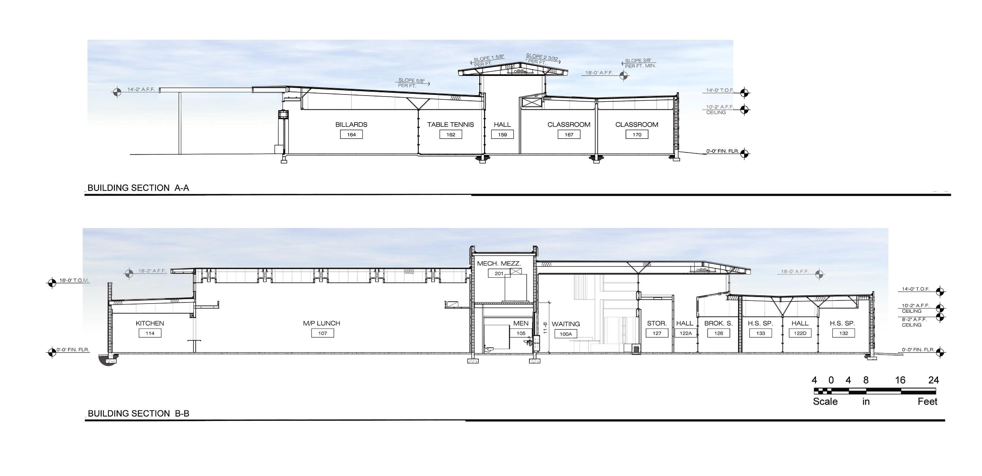
City of Scottsdale Senior Center at Granite Reef
Sections
With Single –family homes opposite the center’s northern boundary the building is arranged so that its more modest activity spaces and offices are aligned on the building’s northern edge, respecting its residential neighbors. Clearstory windows introduce daylight throughout the facility. Solar panels provide significant power for the operation of the building.

Slide 7
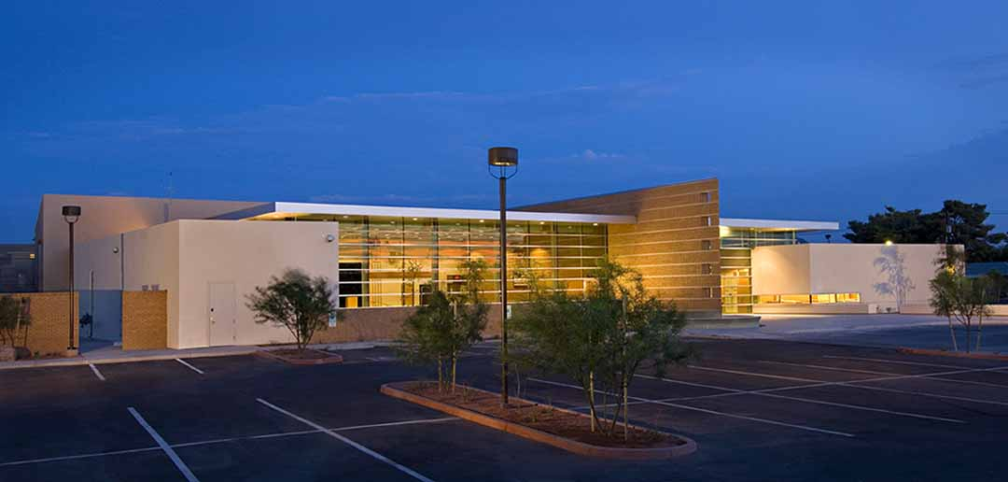
City of Scottsdale Senior Center at Granite Reef
View west from street – The facility will be one of the first LEED TM Gold Certified buildings in Arizona

Slide 8
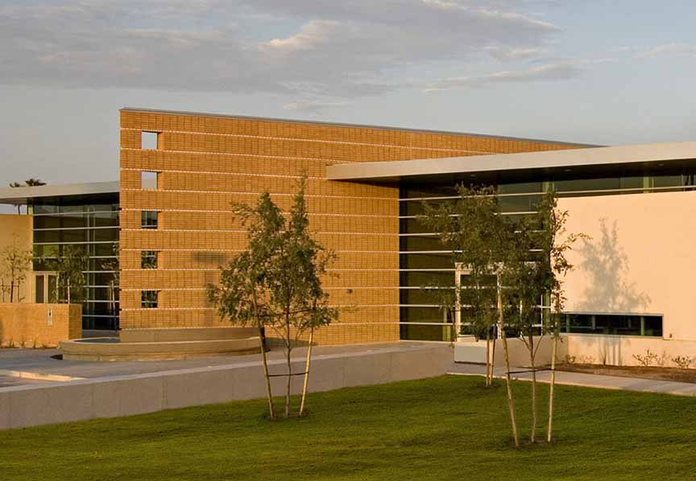
City of Scottsdale Senior Center at Granite Reef
View southwest - The sweeping, brick volume at the center of the building serves as a defining element and provides thermal mass that maintains temperatures within the human comfort range.

Slide 9
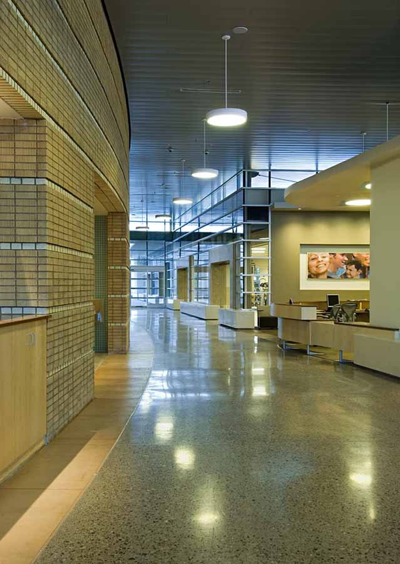
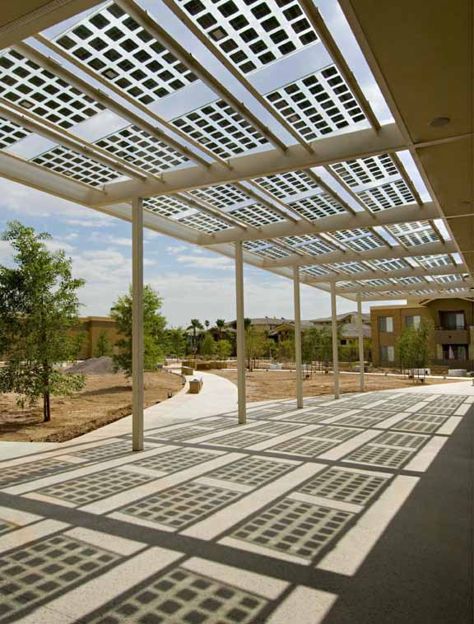
City of Scottsdale Senior Center at Granite Reef
View west at Lobby and Patio - Through passive and active solar design along with high efficiency HVAC systems, energy usage is reduced by 282,000 kWh/year.

Slide 10
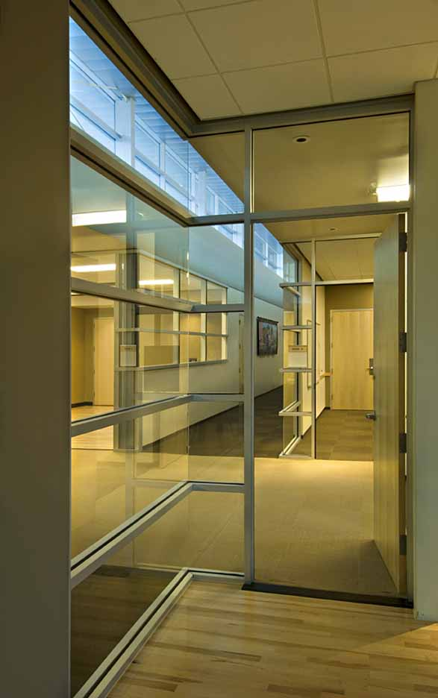
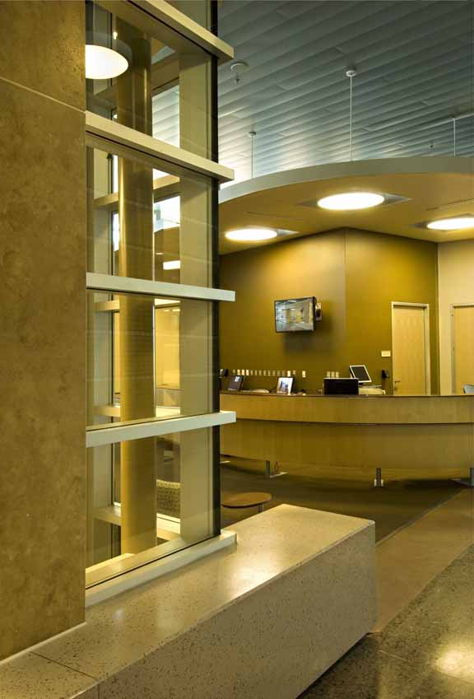
City of Scottsdale Senior Center at Granite Reef
Interior Glazing and Reception Counter - Daylighting is introduced to all activity and office spaces with windows aligned so that outdoor vistas are seen deep within the building.

Slide 11
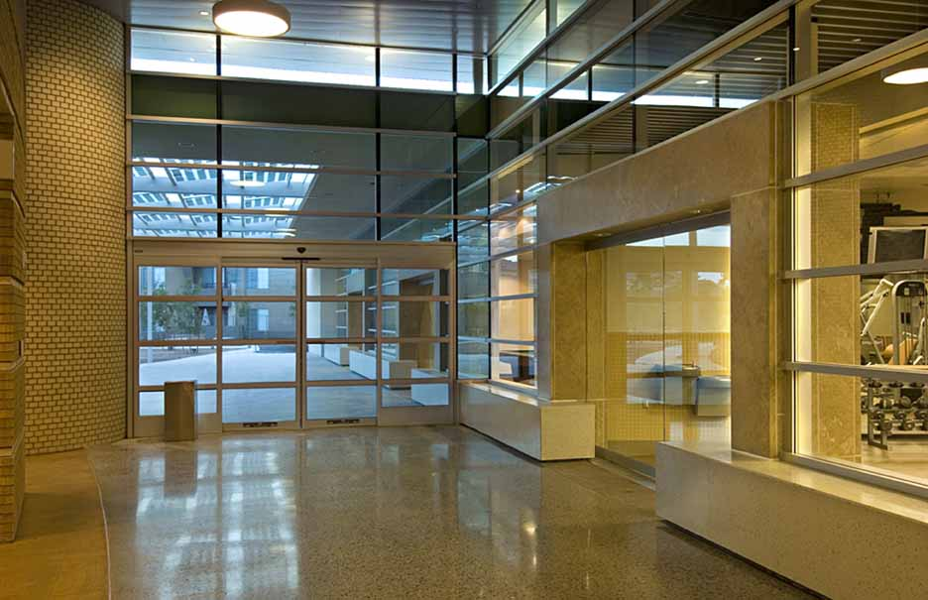
City of Scottsdale Senior Center at Granite Reef
Central Lobby – 75% of the construction waste (1400 tons) was directed to recycling plants. 50% of the construction materials were harvested locally, minimized energy usage for transportation.

Slide 12
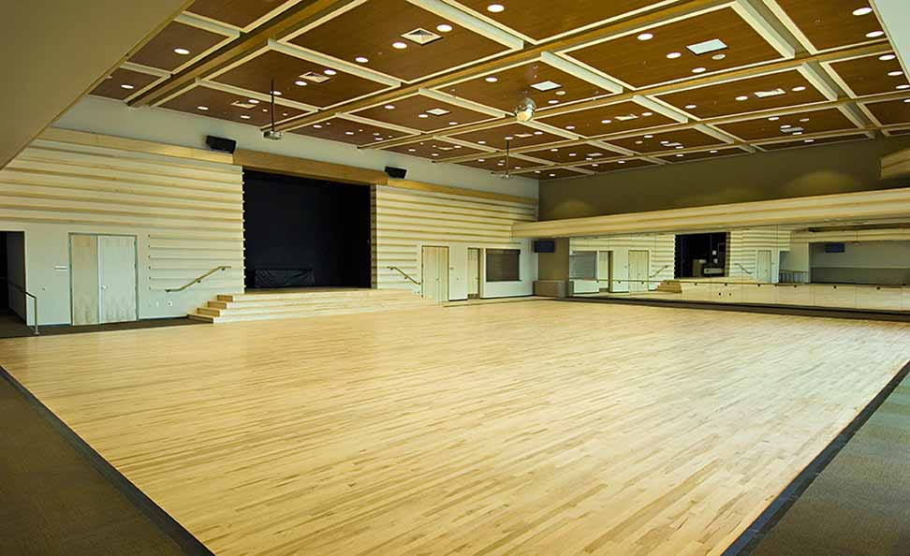
City of Scottsdale Senior Center at Granite Reef
Dance Hall – The lofty volume of the Dance Hall is supported by beams that were manufactured from lumber harvested from certified, responsibly managed forests.

Slide 13
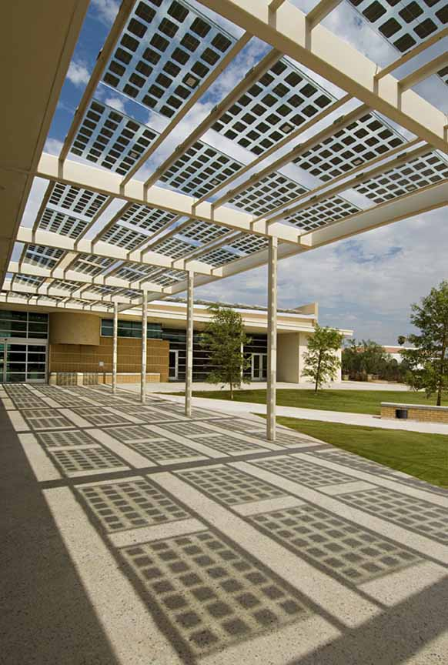
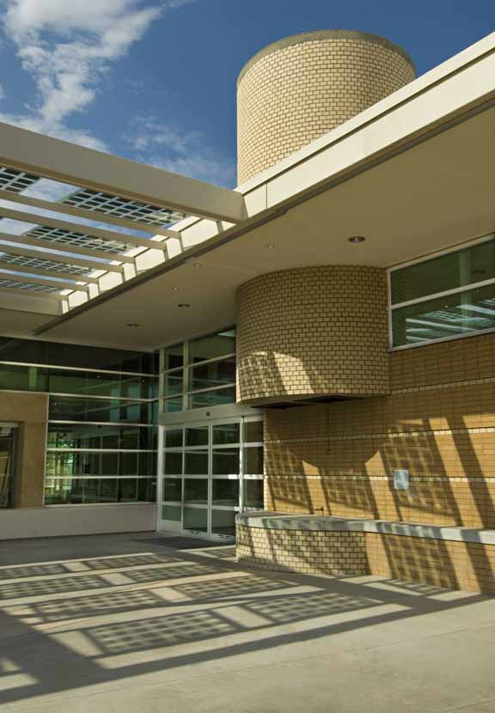
City of Scottsdale Senior Center at Granite Reef
View east at south patio – The Scottsdale Senior Center is built over a brownfield site that was remediated under the Environmental Protection Agency Superfund program.

Slide 14
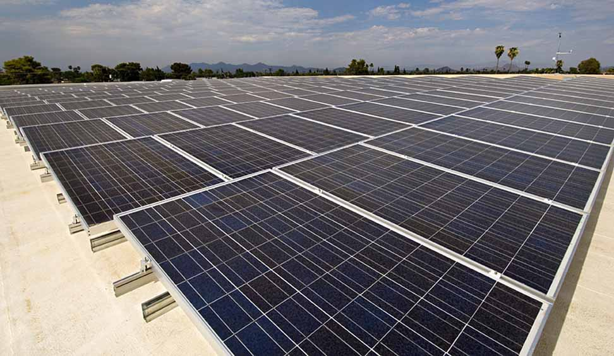
City of Scottsdale Senior Center at Granite Reef
View northeast at Dance Hall roof - This solar array installed in cooperation with SRP generates in excess of 30 kW, nearly taking the facility off-line in the winter.

Slide 15
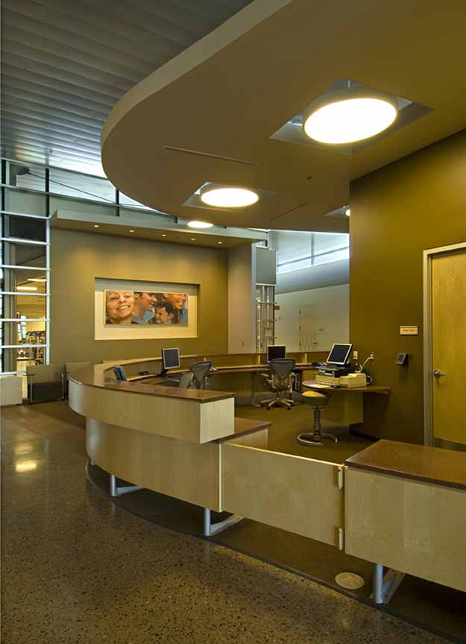
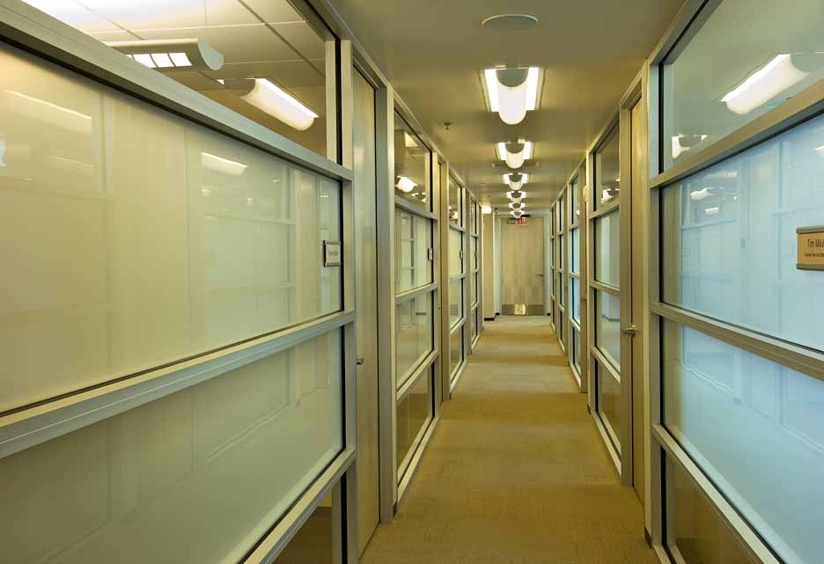
City of Scottsdale Senior Center at Granite Reef
Reception Counter and Hallway at Administration Area - The comfortable interior environment is both friendly and energy efficient through intelligent use of daylight, materials, color and scale.

Slide 16
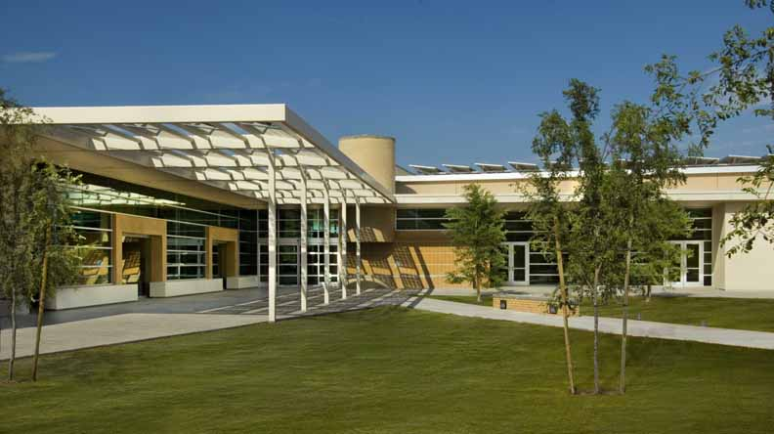
City of Scottsdale Senior Center at Granite Reef
View east at Courtyard and south side of building - Transparent solar panels are both functional and an elegant design feature. Activity spaces visually and physically spill out onto the patio.

Slide 17
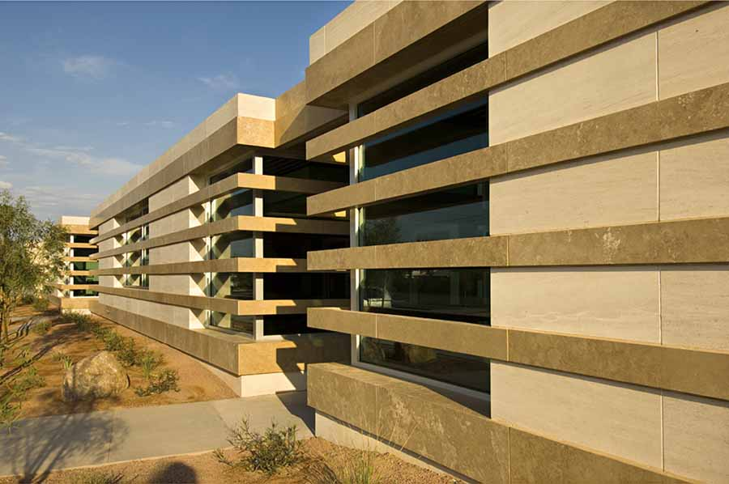
City of Scottsdale Senior Center at Granite Reef
View east at north side of building – Water consumption is substantially reduced (30% below industry standards) with the use of drought resistant plant material, drip irrigation systems with sophisticated controllers and low-water plumbing fixtures.

Slide 18
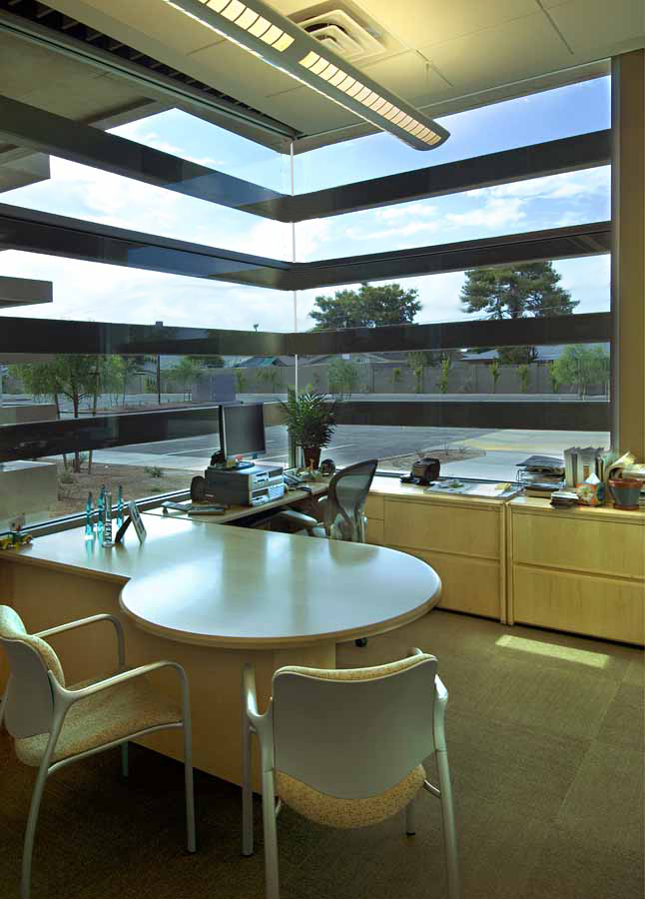
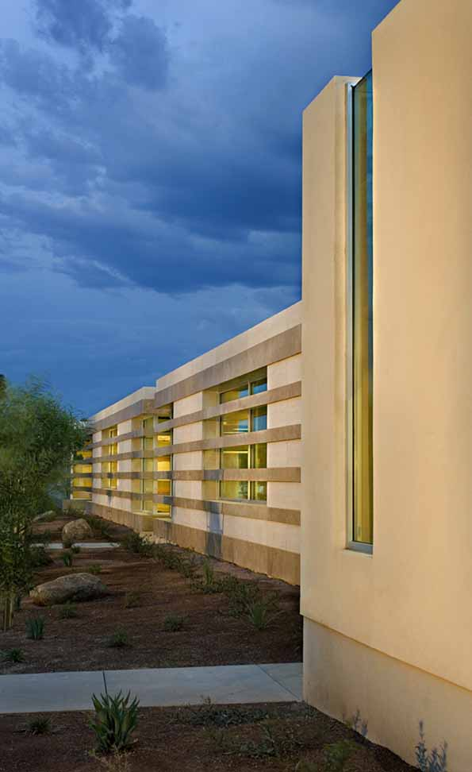
City of Scottsdale Senior Center at Granite Reef
View east at north side and from corner office - The Scottsdale Senior Center is the flagship for the City’s Green Building Program, with its public education program that raises awareness of environmentally conscious design, construction and building operation.

